Slide 1
NIFF 2020
Gender Analysis

Slide 2
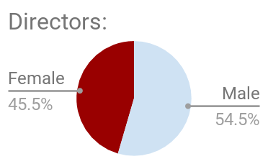
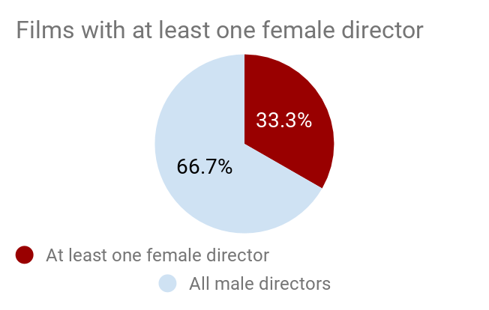
Directors:
% of female and male directors at NIFF 2020.
% of films with at least one female director at NIFF 2020.

Slide 3
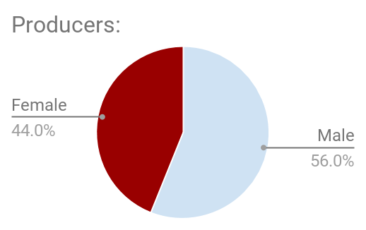
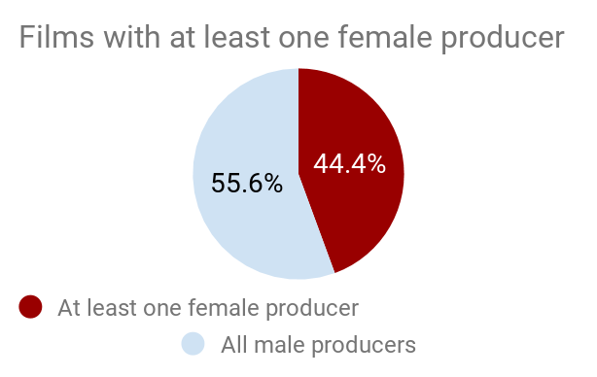
Producers:
% of female and male producers at NIFF 2020.
% of films with at least one female producer at NIFF 2020.

Slide 4
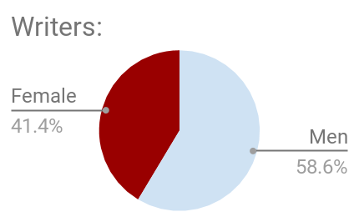
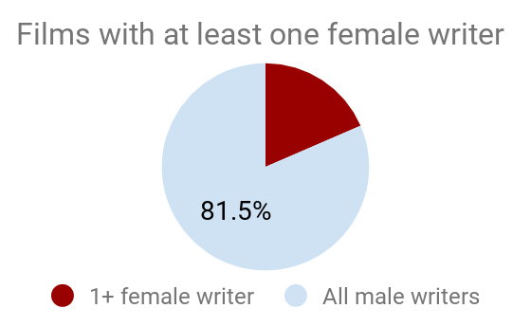
Writers:
% of female and male writers at NIFF 2020.
% of films with at least one female writer at NIFF 2020.

Slide 5
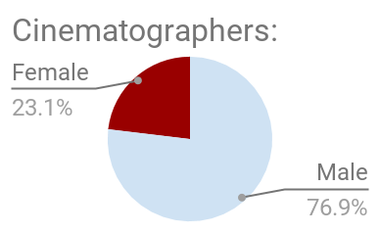
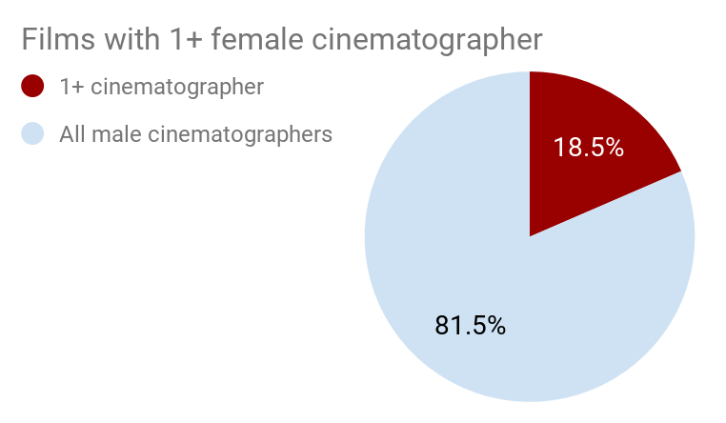
Cinematographers:
% of female and male cinematographers at NIFF 2020.
% of films with at least one female cinematographer at NIFF 2020.

